Slide 1
DMS

Slide 2
壹
Requirements
目录
贰
Features
叁
Design Patterns
肆
Summary

Slide 3
壹
Requirements

Slide 4

Background
With the fast-growing popularity of online shopping, the express delivery industry is booming. Indeed, the delivery service is facilitating our life and work
As more and more people choose to shop online, there comes the relative services, the most important one is express deliver

Slide 5

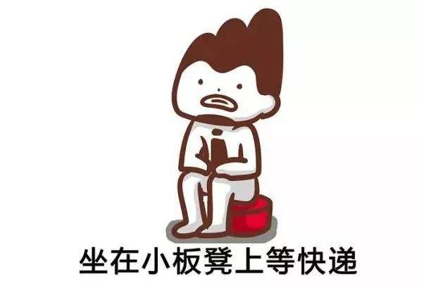

Student
Businessman
I often shopping online, I hope to check my package information at any time.
I am very busy, I can't collect my package on time, I need express proxy service

Slide 6


Analyze
However, there are also many problems in our express industry. For example: there are a lot of small company with old management mode, only forcus on their own profits,but they ignore considering the entire enterprise's long-term development
Here we are
We should take some measures to improve the situation, DMS is born for this purpose.

Slide 7
贰
Features

Slide 8
DMS
EPS
ESS
QES
Express Proxy Service
Express Sending Service
Query Express Service

Slide 9
EPS
ESS
QES
We provide express proxy service which means that you don't have to worry about your packages being lost, because we will receive and organize your packages for you, and then wait for you to collect them.
If you need to send a express, please contact us, we will provide you with the most professional service.Come to us with your package, and leave the rest to us.
The time to wait for the courier is always like "pass a day as if it were a year". If you want to query more about your express, please log in to oursystem and check with tracking number or shopping information.

Slide 10
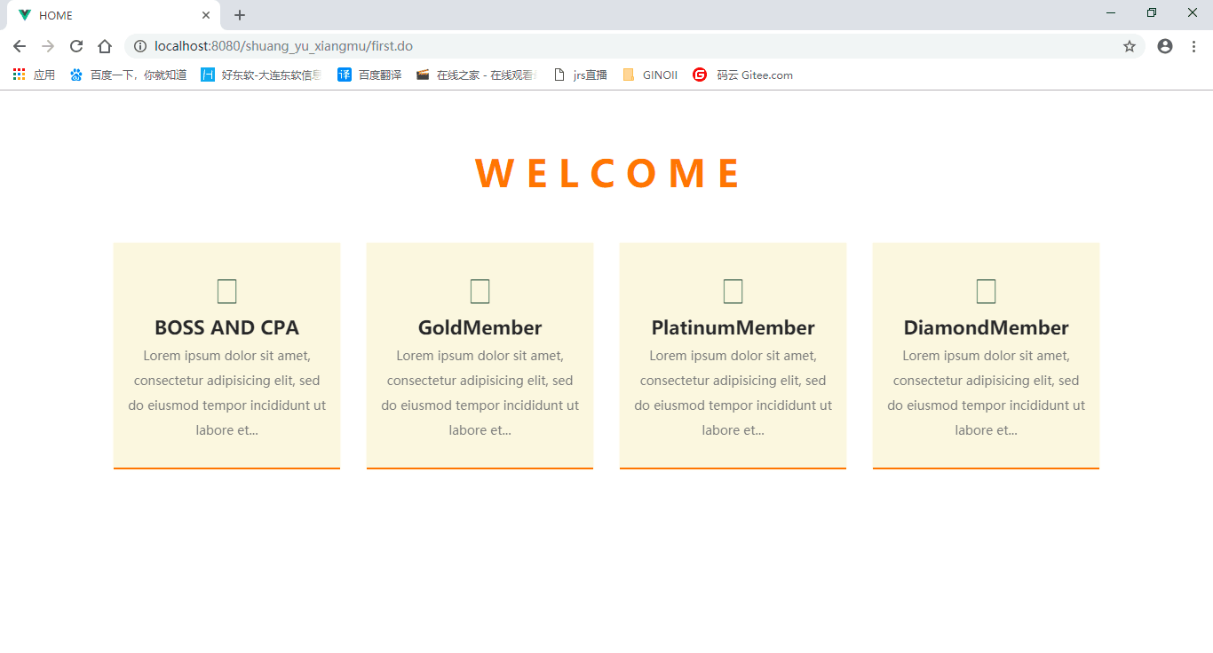
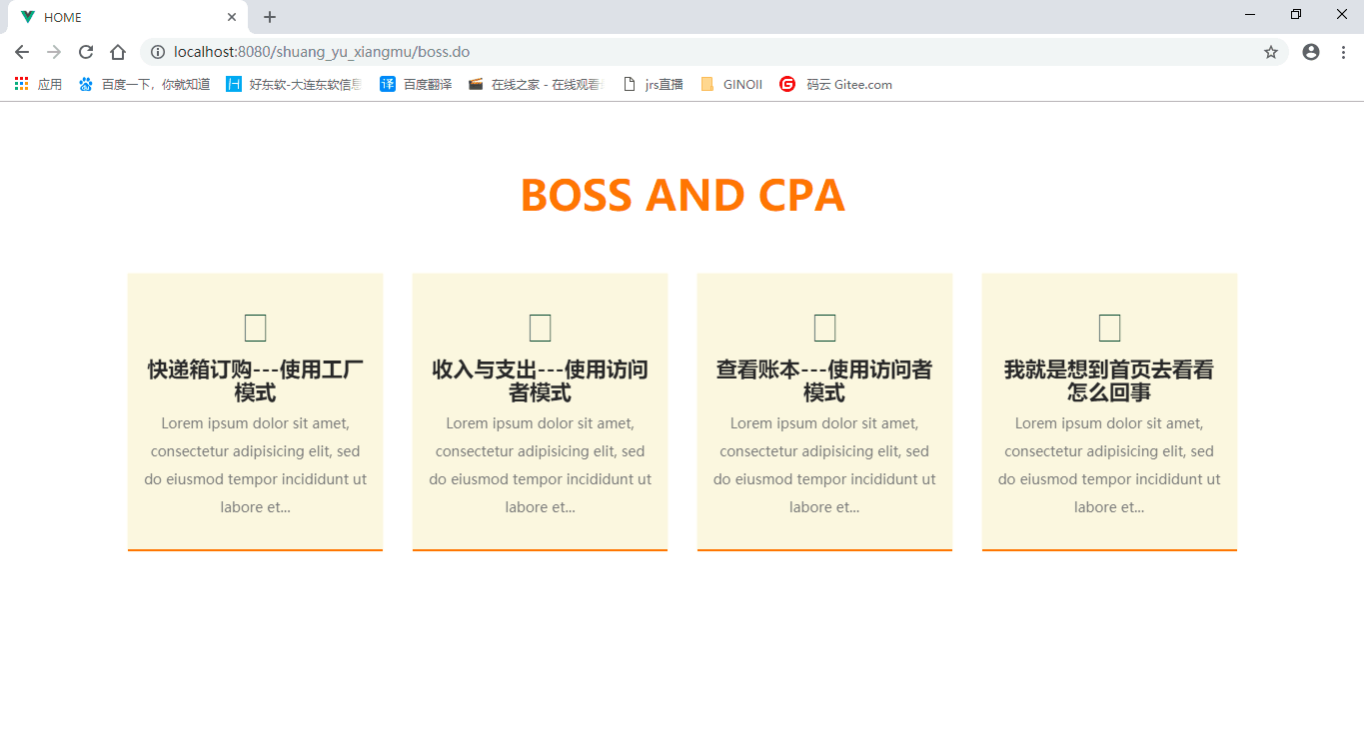
Multiple Entrance Provide More Services
Boss And CPA View

Slide 11
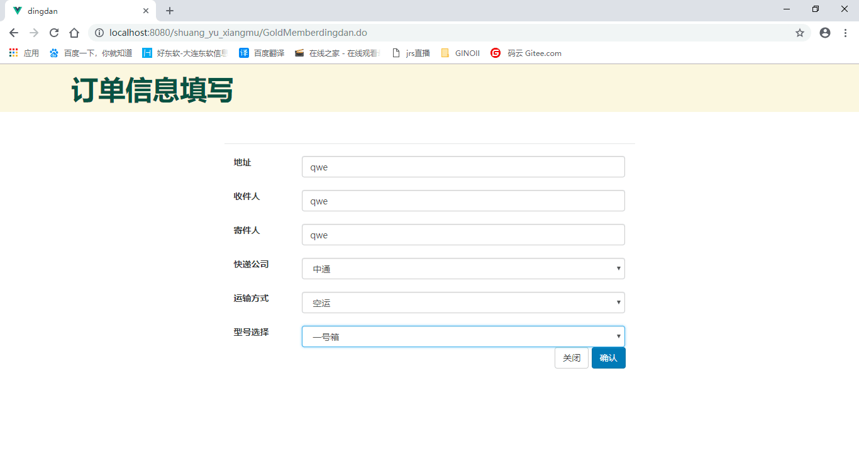
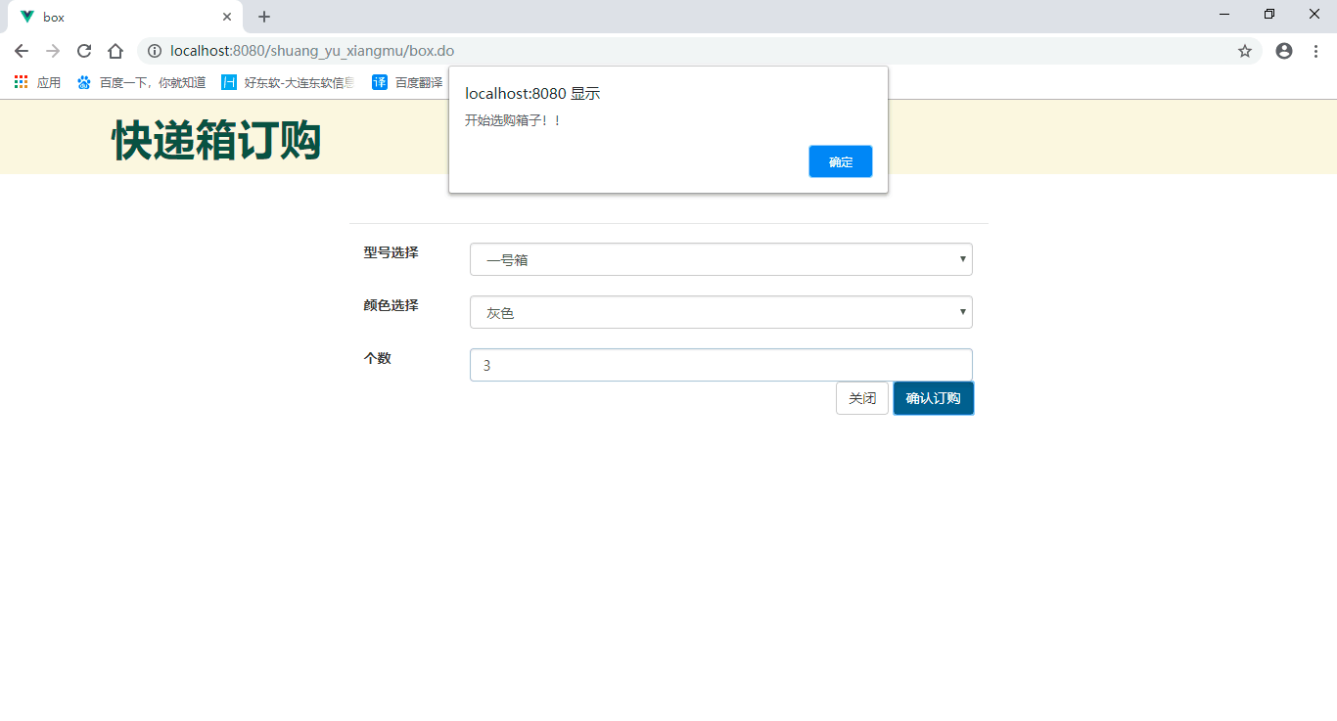
Boss Can Order Various Types Of Courier Boxes
Customers Can Send Expresses Anytime

Slide 12
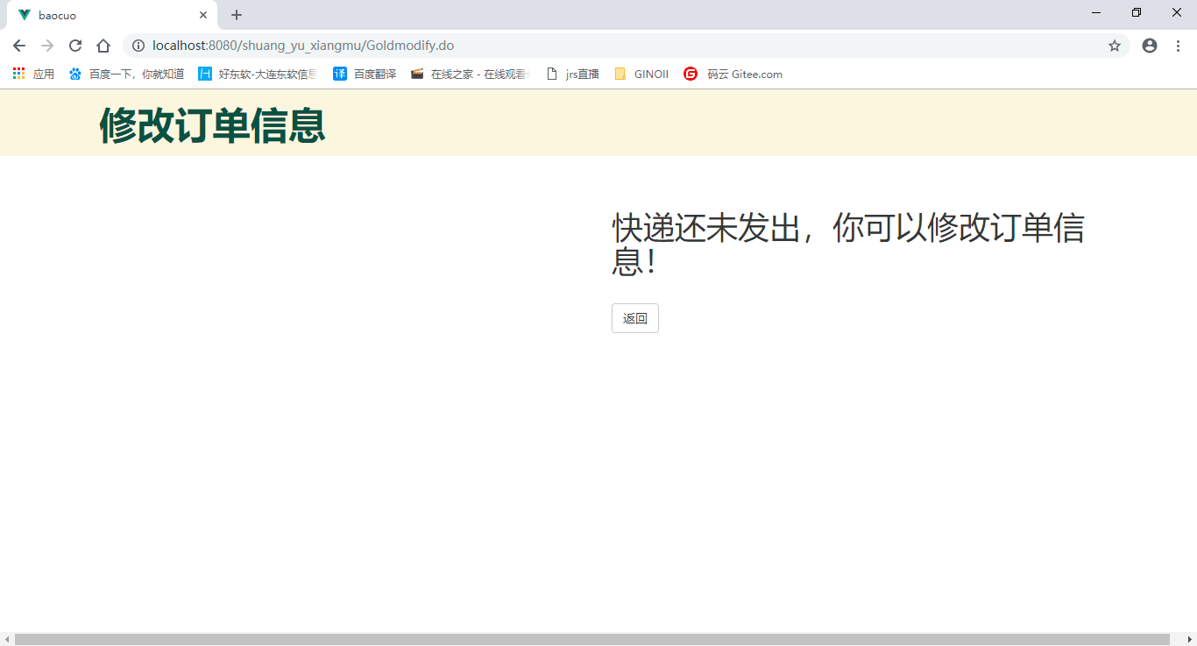
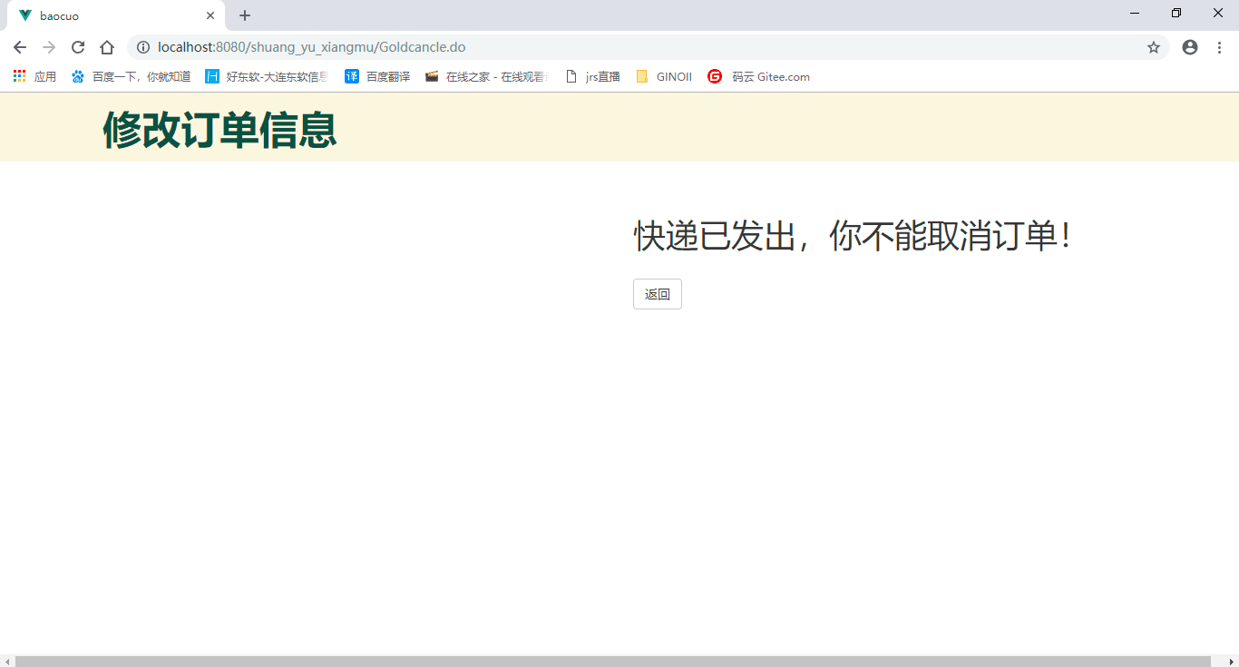
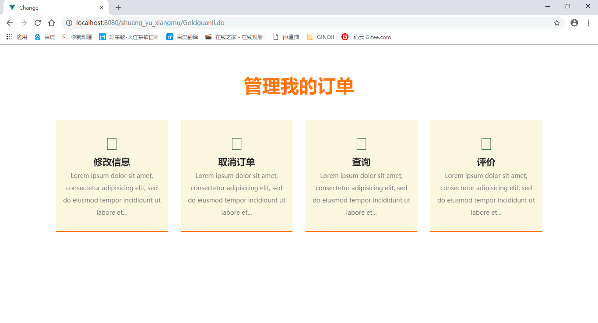
A More Convenient Way To Manage Express Delivery

Slide 13
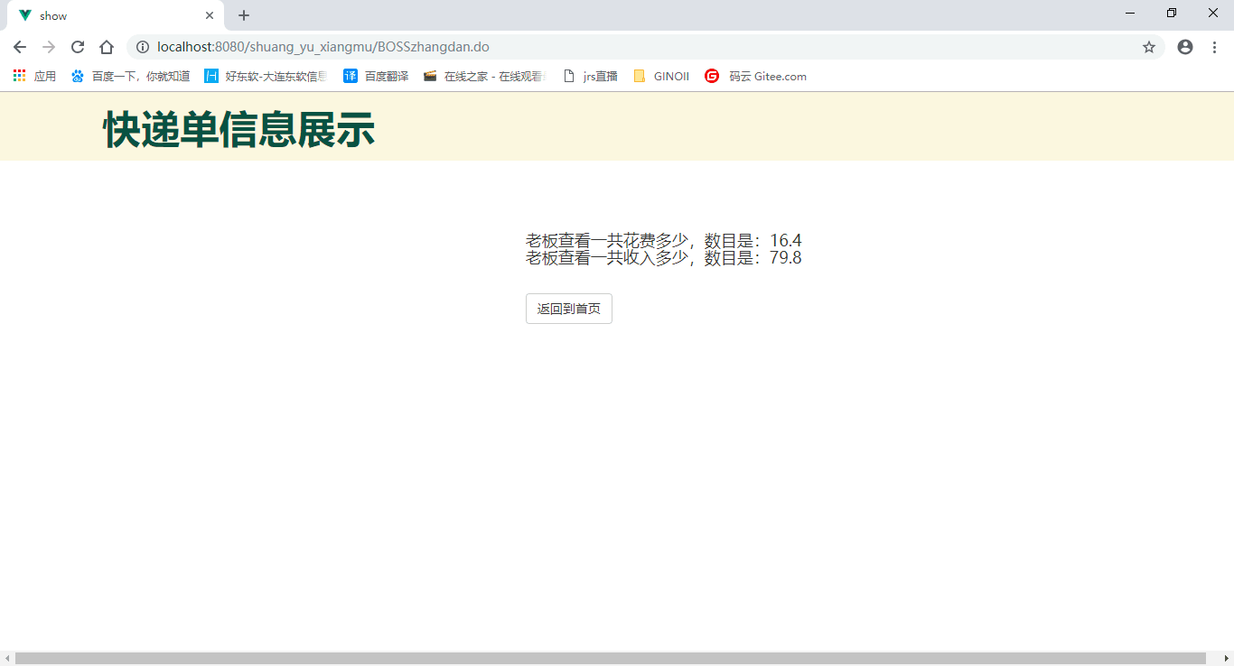
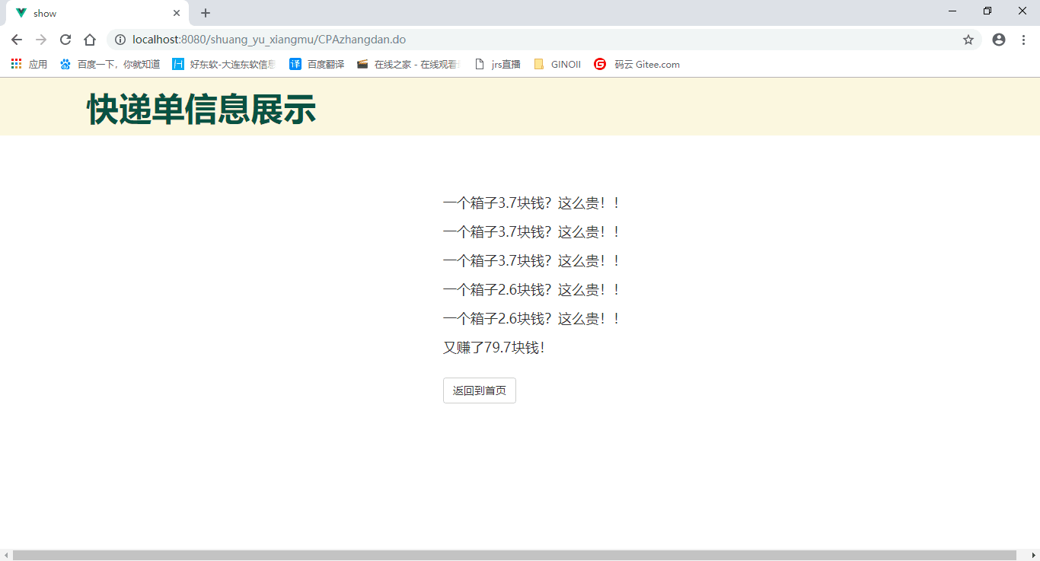
Data
Clearer

Slide 14
叁
Design Patterns

Slide 15
Factory Pattern
Decorator Pattern
工厂模式
装饰者模式
State Pattern
Visitor Pattern
状态模式
访问者模式
Strategy Pattern
Bridge Pattern
策略模式
桥接模式

Slide 16
Product express boxes and packages
Track the status of the express
Factory Pattern
Decorator Pattern
State Pattern
Strategy Pattern
Fill in the delivery form
VIP system

Slide 17
Visitor Pattern
Choose express delivery method
Query the bill
Bridge Pattern

Slide 18
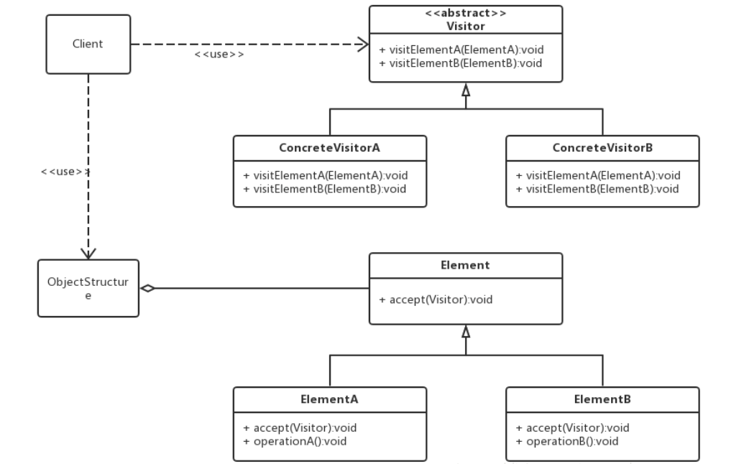
Define a new operation to deal with the classes of the elements without changing their structures.
Visitor Pattern
Data operating
accept
Data structure
软件系统中拥有一个由许多对象构成的、比较稳定的对象结构，这些对象的类都拥有一个 accept 方法用来接受访问者对象的访问。访问者是一个接口，它拥有一个 visit 方法，这个方法对访问到的对象结构中不同类型的元素做出不同的处理。在对象结构的一次访问过程中，我们遍历整个对象结构，对每一个元素都实施 accept 方法，在每一个元素的 accept 方法中会调用访问者的 visit 方法，从而使访问者得以处理对象结构的每一个元素，我们可以针对对象结构设计不同的访问者类来完成不同的操作，达到区别对待的效果。

Slide 19
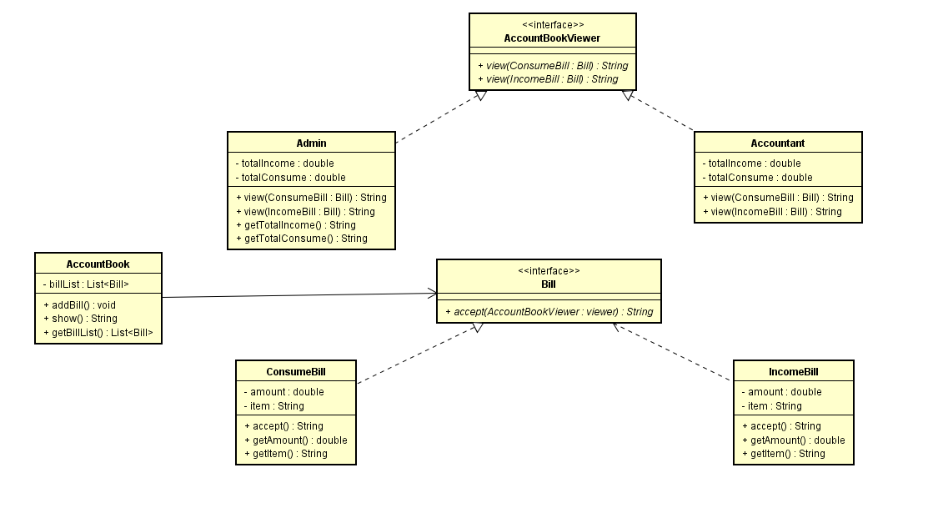
Visitor Pattern
According to different needs, the boss and accountant are provided with different query bill pages.

Slide 20
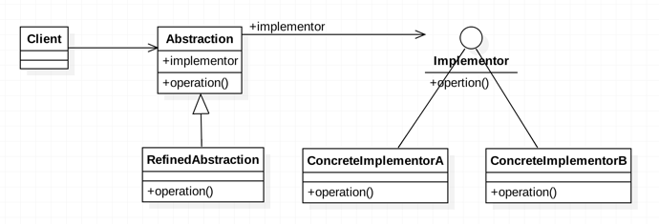
Decouple an abstraction or interface from its implementation so that the two can vary independently.
Bridge Pattern
It reduces the coupling between classes and classes, reduces the number of classes in the system, and reduces the amount of code.
桥接模式即将抽象部分与它的实现部分分离开来，使他们都可以独立变化;将继承关系转化成关联关系，它降低了类与类之间的耦合度，减少了系统中类的数量，也减少了代码量
实现系统可能有多个角度分类，每一种角度都可能变化，那么把这种多角度分类给分离出来让他们独立变化，减少他们之间耦合

Slide 21
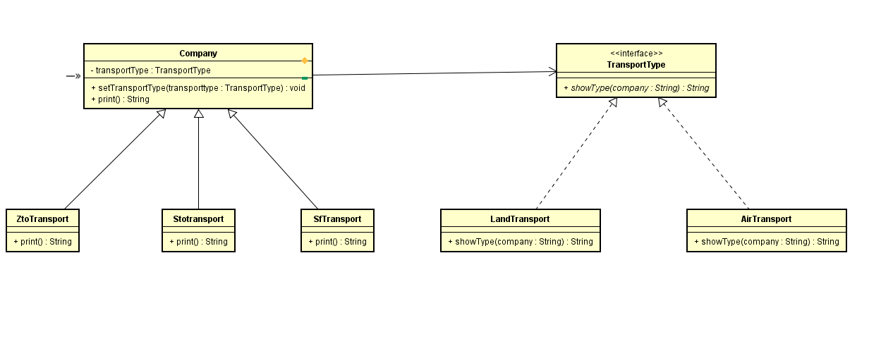
Bridge Pattern
Provide a more flexible delivery options

Slide 22
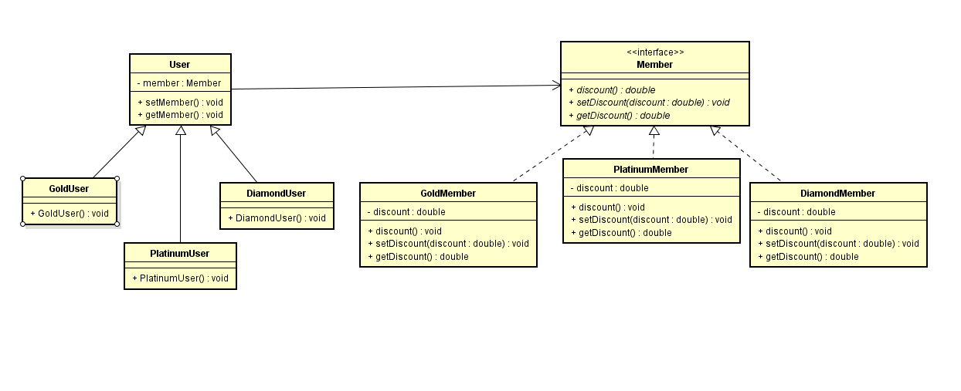
Strategy Pattern
Define a family of algorithms, encapsulate each one, and make them interchangeable.

Slide 23
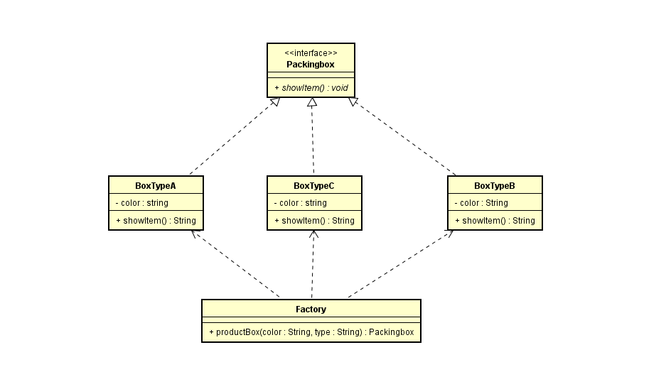
Factory Pattern
Define an interface for creating an object,but let subclass decide which class to instantiate.Factory Method lets a class defer instantiation to subclass.

Slide 24
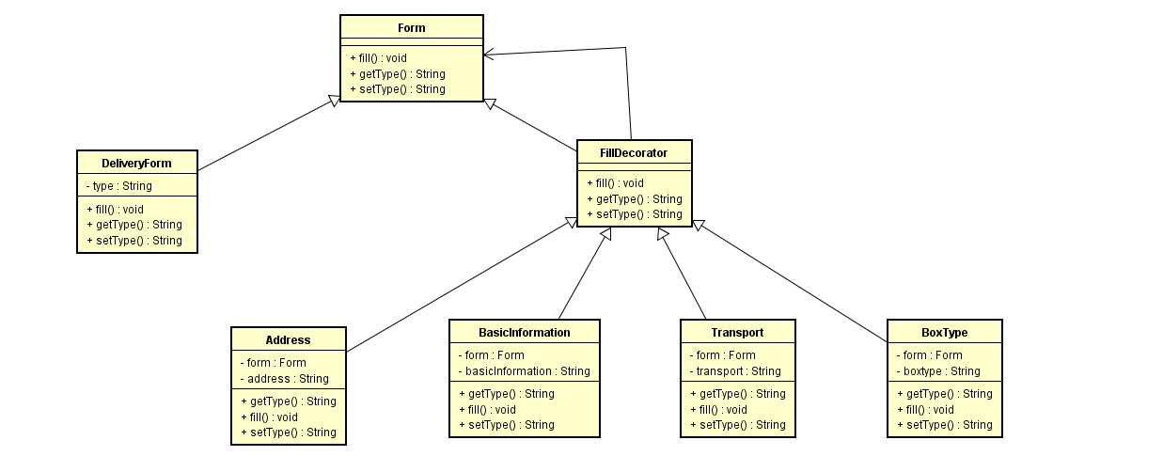
Decorator Pattern
Attach additional responsibilities to an object dynamically keeping the same interface.Decorators provide a flexible alternative to subclassing for extending functionality.

Slide 25
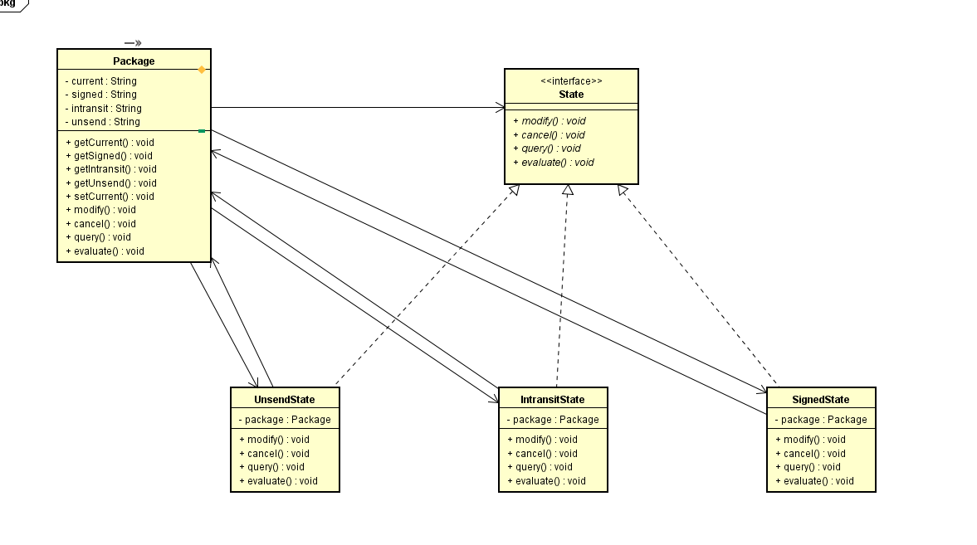
State Pattern
Allow an object to alter its behavior when its internal state changes.The object will appear to change its class.

Slide 26
肆
Summary

Slide 27

Teamwork
01
With the help of the team, these problems can be solved easily and quickly, which could improve work efficiency.
Reviewing
02
Reviewing is helpful in understanding and memorizing what you’ve learnt.
Practice
02
The old saying gi ven by Einstein——“The only source of knowledge is practice. ”

Slide 28
Design pattern is a universal solution for design problems
Use design patterns to apply it to specific applications to solve similar problems.
The design pattern is used to re-use code, make the code easier to understand, and ensure code reliability.
0

Slide 29
Thanks

